Slide 1
Absolute vorticity, 2D Rossby waves, and downstream development
Brian Mapes
ATM407
Sept 8, 2020

Slide 2
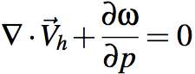
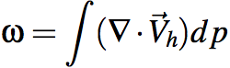
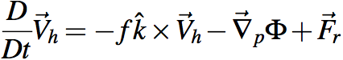
Holy grail of dynamics: get ω
There it is! Grab it!
Yeah I took Calc 1
Oops, it's hooked to wind
uhh, ... this could take awhile
at least let’s ignore friction…
Notes:
\omega = \int (\nabla \cdot \vec V_h) dp
\frac{D}{Dt} \vec V_h = -f \hat k \times \vec V_h - \vec \nabla_p \Phi +\vec F_r
\frac {\partial \Phi}{\partial p} = - \alpha \equiv -\frac{1}{\rho}
\alpha = \frac{RT}{p}
\frac {\partial u}{\partial x} + \frac {\partial v}{\partial y} + \frac {\partial \omega}{\partial p} = 0
\frac {D \theta}{Dt} = S_{\theta}

Slide 3
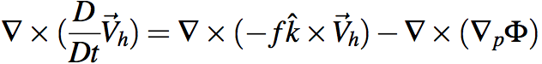
Holy grail of dynamics: get ω
Gotta avoid dragging thermo into this via Φ.
Get rid of Φ at any cost. Curl to the rescue!
Ker-CHING!
We are Masters of the Universe with our sexy vector identities!
The grail is in the bag!
Notes:
\nabla \times (\frac{D}{Dt} \vec V_h) = \nabla \times (-f \hat k \times \vec V_h) - \nabla \times (\nabla_p \Phi)

Slide 4
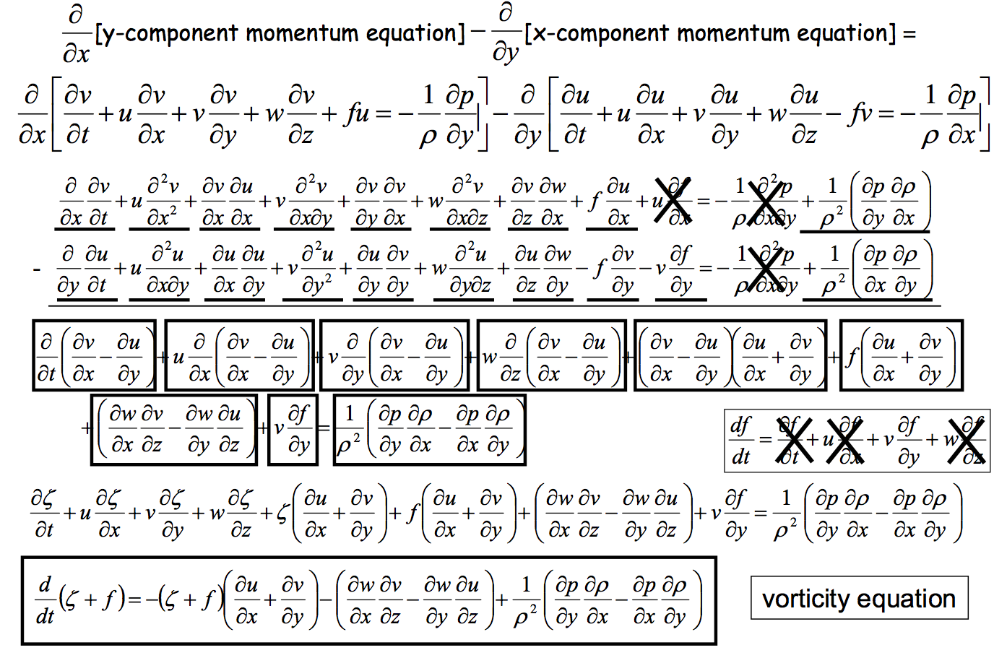
Heh heh ... did I say "any cost"... ? gulp
Can we scrape back some of these cobwebs?
Wait a sec, what's this??

Slide 5
A glimpse of gold
Zero on a p surface
Inconvenient*
Yesssss
*and can be shown to be small if δx and δy are very large and w is very small.
We’ll settle for a large-scale grail.

Slide 6
Relative, planetary, and absolute vorticity
absolute = (relative + planetary): ζ_{abs}= ζ_{rel} + ζ_{plan}
planetary vorticity ζ_{plan} = f (aka the “Coriolis parameter”)
f = 2Ω cos(latitude)
Ω = (2π radians)/(1 day) since the Earth turns once a day
At 40N, f = 10⁻⁴ s⁻¹ and it increases with latitude
Notes:
\frac {D\zeta_{abs}} {Dt} \simeq 0
\frac {\partial \zeta_{abs}} {\partial t} \simeq -\vec V \cdot \vec \nabla_p \zeta_{abs} - \omega \frac {\partial \zeta_{abs}} {\partial p}

Slide 7
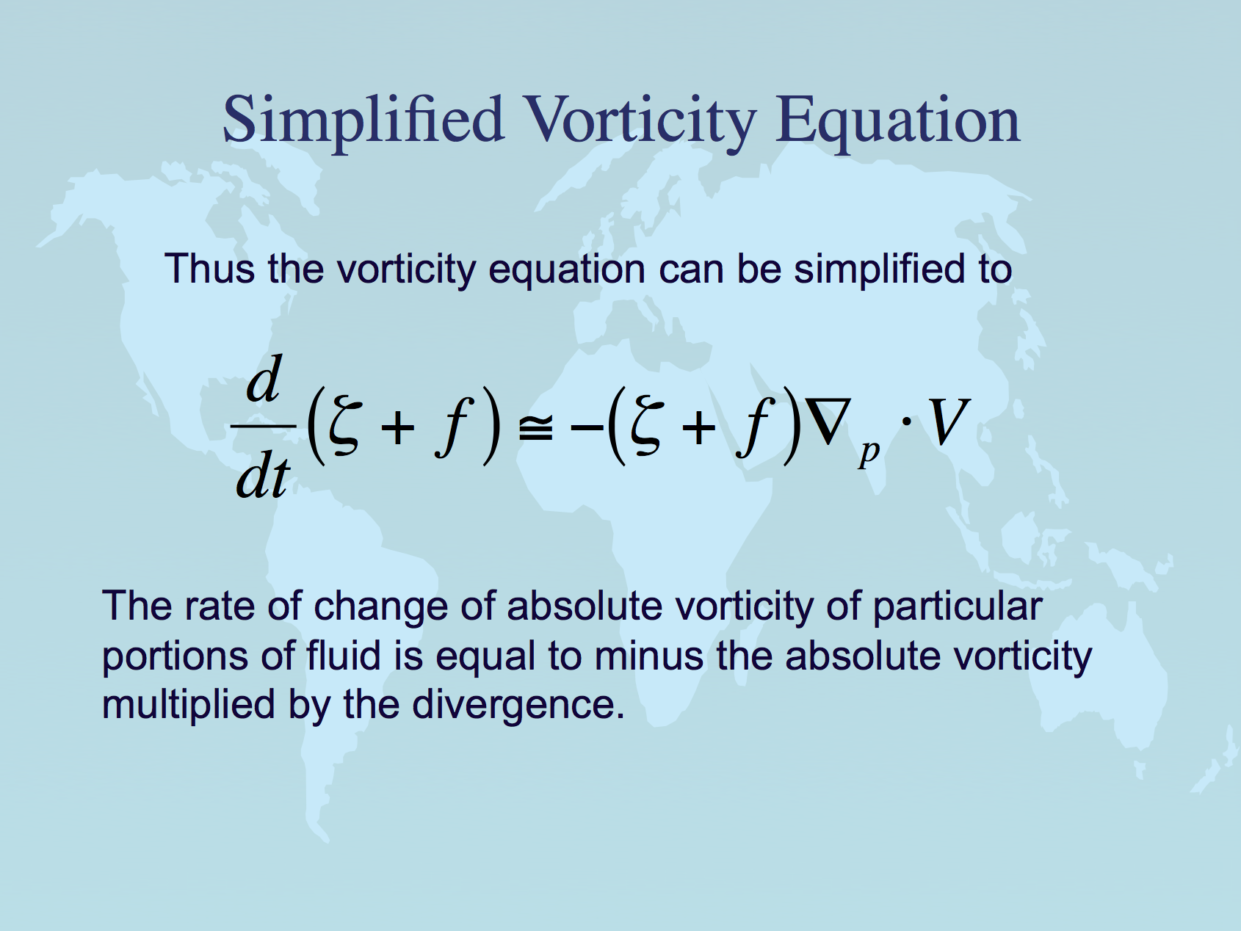
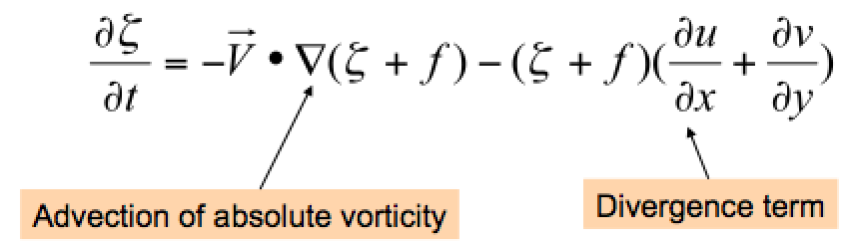
Same equation in Eulerian (local rate of change with time) form.
Lackmann Eq. 1.51

Slide 8
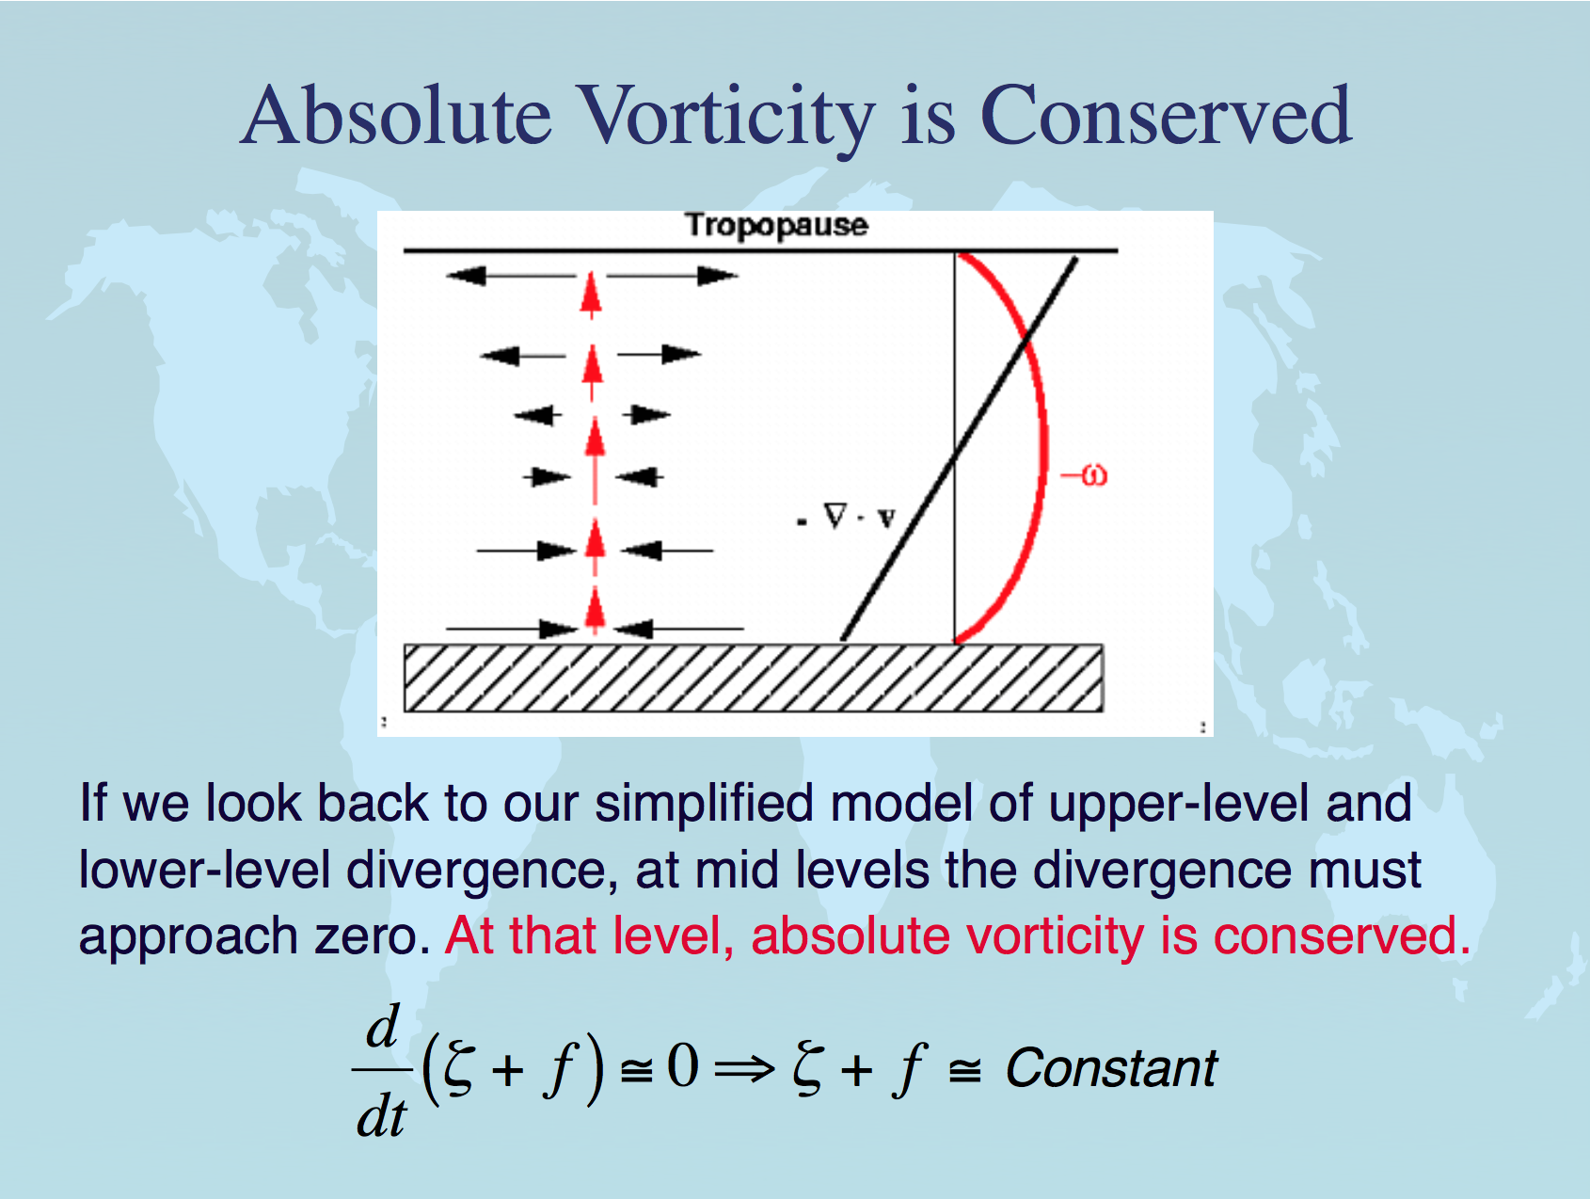
almost
←
at 500mb

Slide 9
Conservation of absolute vorticity: how?
When air moves north or south, it tends to conserve its absolute vorticity -- or in other words it converts planetary to relative vorticity. How?
Consider equatorward motion of a disc of fluid.
The initially high f = ζ_{plan} is converted to ζ_{rel}. How?
Physically, the Coriolis force fv is a little bit stronger on its poleward edge (where f is bigger) than on its equatorward edge. This imparts a cyclonic torque on the disk of fluid as it moves southward.
fv
v
All v winds the same, as the disk
moves southward as a unit →
(an eastward PGF must balance the mean Coriolis force, to keep the air flowing southward)
v
fv
v
v
Notes:
\frac {D\zeta_{abs}} {Dt} \simeq 0
\frac {\partial \zeta_{abs}} {\partial t} \simeq -\vec V \cdot \vec \nabla_p \zeta_{abs} - \omega \frac {\partial \zeta_{abs}} {\partial p}

Slide 10
Rossby waves: theory
Consider a simple westerly flow (constant value of U)
Sinusoidal wave pattern in v is superimposed
Wave assumed to propagate eastward at phase speed c
Wavelength = L
north
Height contours
Notes:
2

Slide 11
Compute the vorticity for this flow… only v varies, and only in x
Now, take time derivative of the vorticity, set to zero
Notes:
2

Slide 12
Note that
Cancel common terms, and we have
Rearrange to solve for c…
Notes:
2

Slide 13
Rossby Waves
c: phase speed of wave (speed of movement of troughs, ridges)
Competing effects (positive U, MINUS a positive term):
- Advection of relative vorticity (by U) moves phase eastward
Advection of planetary vorticity vβ moves phase westward
notice that the subtracted term depends on L²: extremely sensitivity to wavelength L
1
Notes:
2

Slide 14
Rossby Wave: Mechanism of phase motion (animation)
Physically, how can we understand tendency for Rossby wave phase (troughs and ridges) to propagate westward relative to the flow?
This is related to the “beta-effect”, or the advection of planetary vorticity (beta β = df/dy >0 reflects the fact that f increases with latitude)
West of trough axis, in northerly flow, larger f is advected : trough “built” there
West of ridge axis, in southerly flow, smaller f is advected: ridge “built” there
north
Result: whole pattern propagates westward. (This works against vorticity advection by U, which acts to push pattern eastward)
Notes:
2

Slide 15
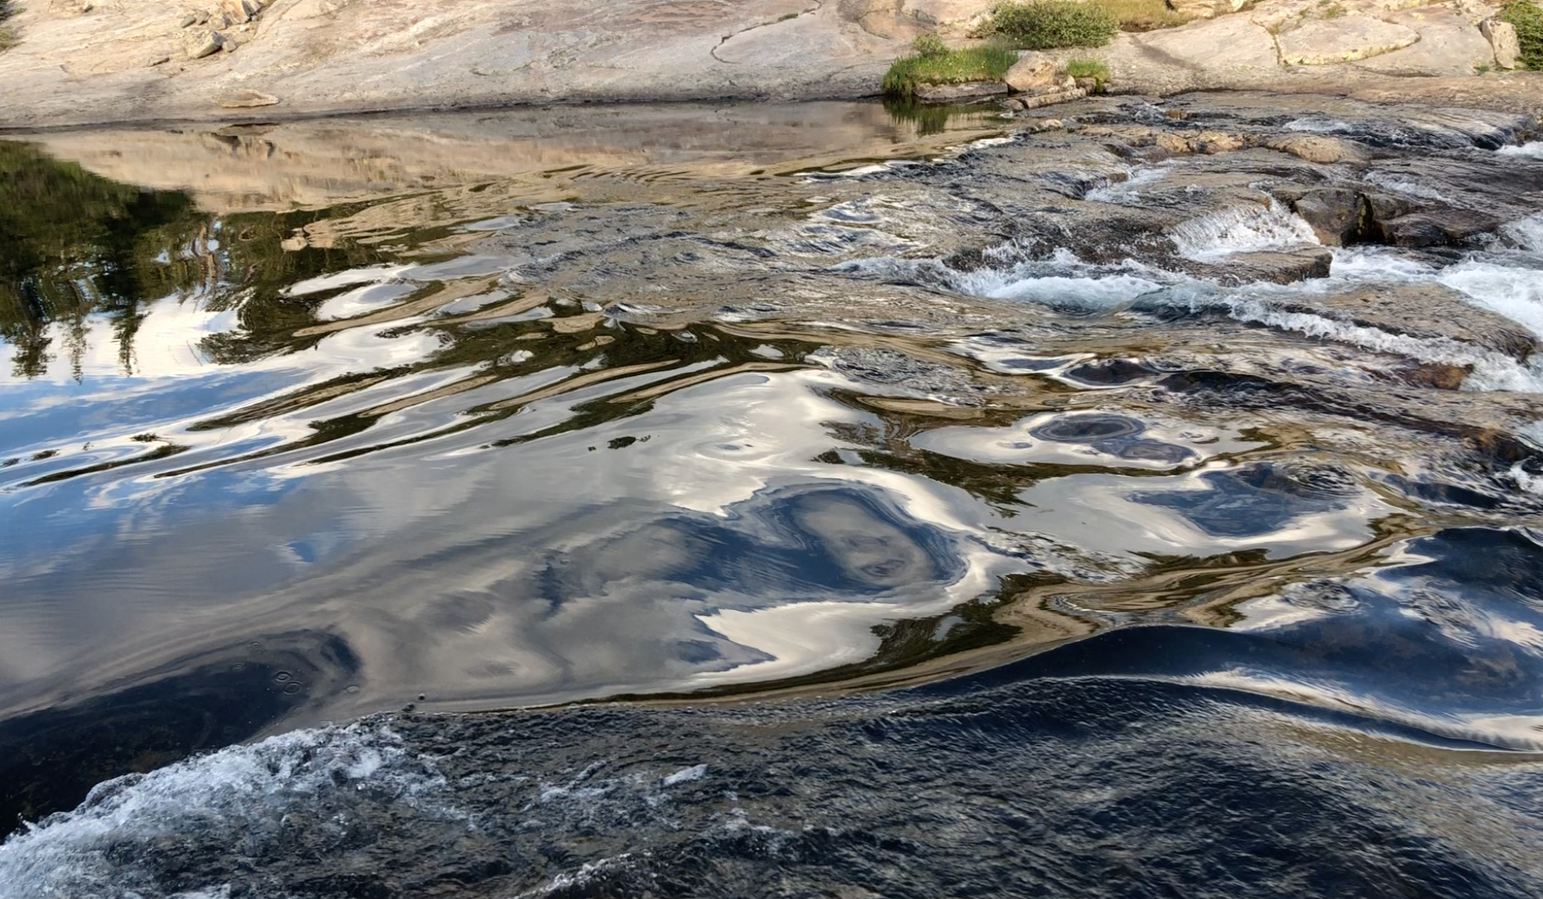
Recall stationary long waves on a river: propagation to left exactly balances advection to right (for long waves).
while little ripples
are simply swept
downstream…

Slide 16
Rossby Waves: phase vs. group velocity
this c is phase velocity
Rossby wave packet energy moves at the GROUP velocity: eastward instead of westward, for Rossby waves.
Note!! →
1
Notes:
2

Slide 17
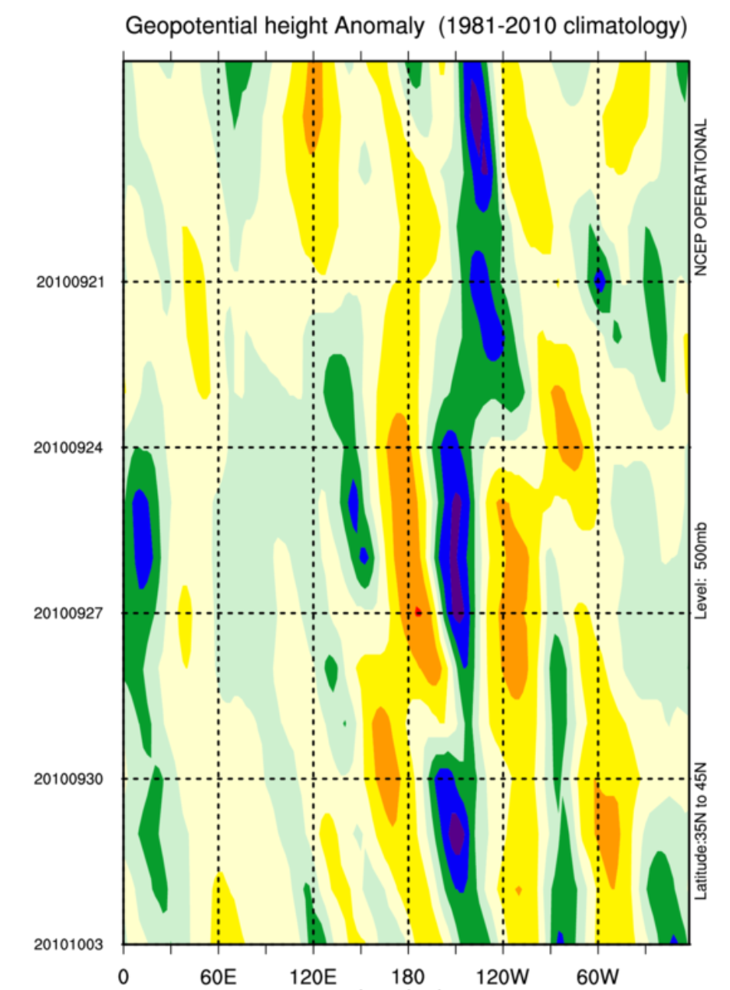
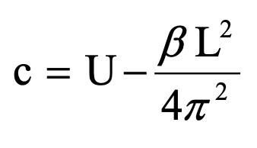
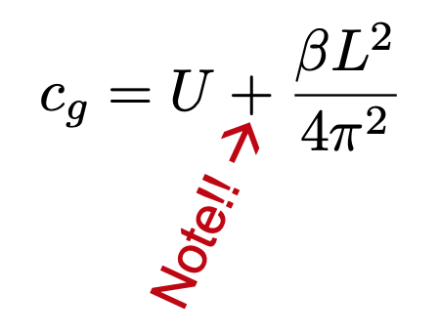
Example:
Z’(lon, time)
diagram
phase velocity near zero (almost stationary waves,) like in the river
time→
group or energy speed: fast eastward: 2U for stationary waves

Slide 18
midlatitude Rossby waves review
Wirth, V., M. Riemer, E.K. Chang, and O. Martius, 2018: Rossby Wave Packets on the Midlatitude Waveguide—A Review.
Mon. Wea. Rev., 146, 1965–2001
https://doi.org/10.1175/MWR-D-16-0483.1

Slide 19

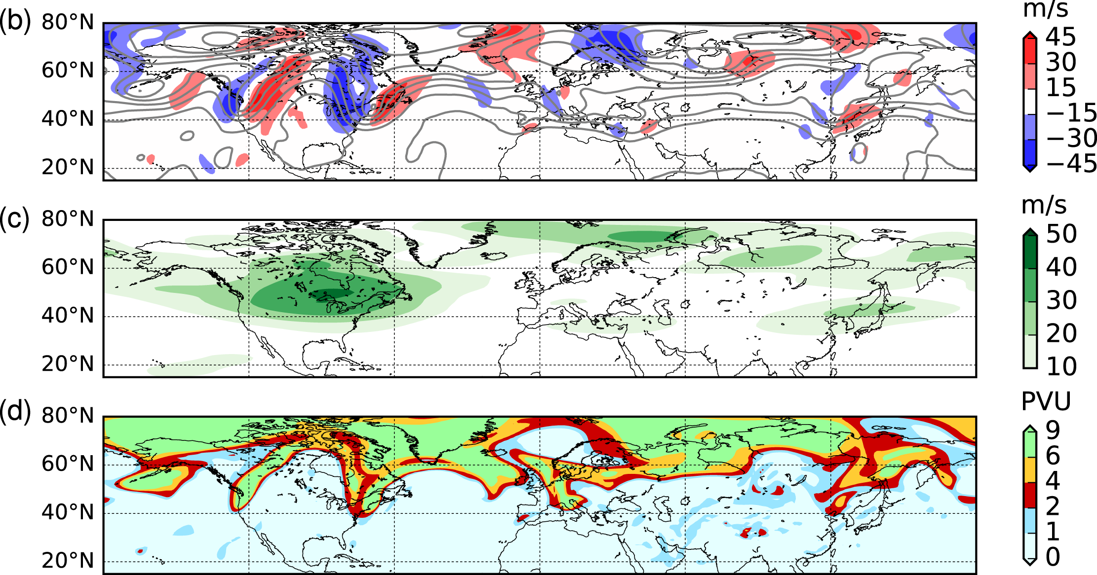
From: Rossby Wave Packets on the Midlatitude Waveguide—A Review
Mon. Wea. Rev.. 2018;146(7):1965-2001. doi:10.1175/MWR-D-16-0483.1
show v
40-60N→
v and Z
u
PV
Figure Legend:
An RWP over North America at 0000 UTC 7 Aug 2002. (a) Magnitude of the horizontal wind at 300 hPa (color shading, in m s⁻¹). (b) Meridional wind υ at 300 hPa (color shading, in m s⁻¹) and isolines of 300-hPa geopotential height Z (black contours, every 150 m). (c) Envelope (color shading, in m s⁻¹) of the meridional wind υ at 300 hPa. (d) Ertel potential vorticity on the 330-K isentrope (color shading, in PVU; 1 PVU = 10⁻⁶ K kg⁻¹ m² s⁻¹). The data used for this figure are from the ERA-Interim project (Dee et al. 2011).
Copyright © 2020 American Meteorological Society

Slide 20
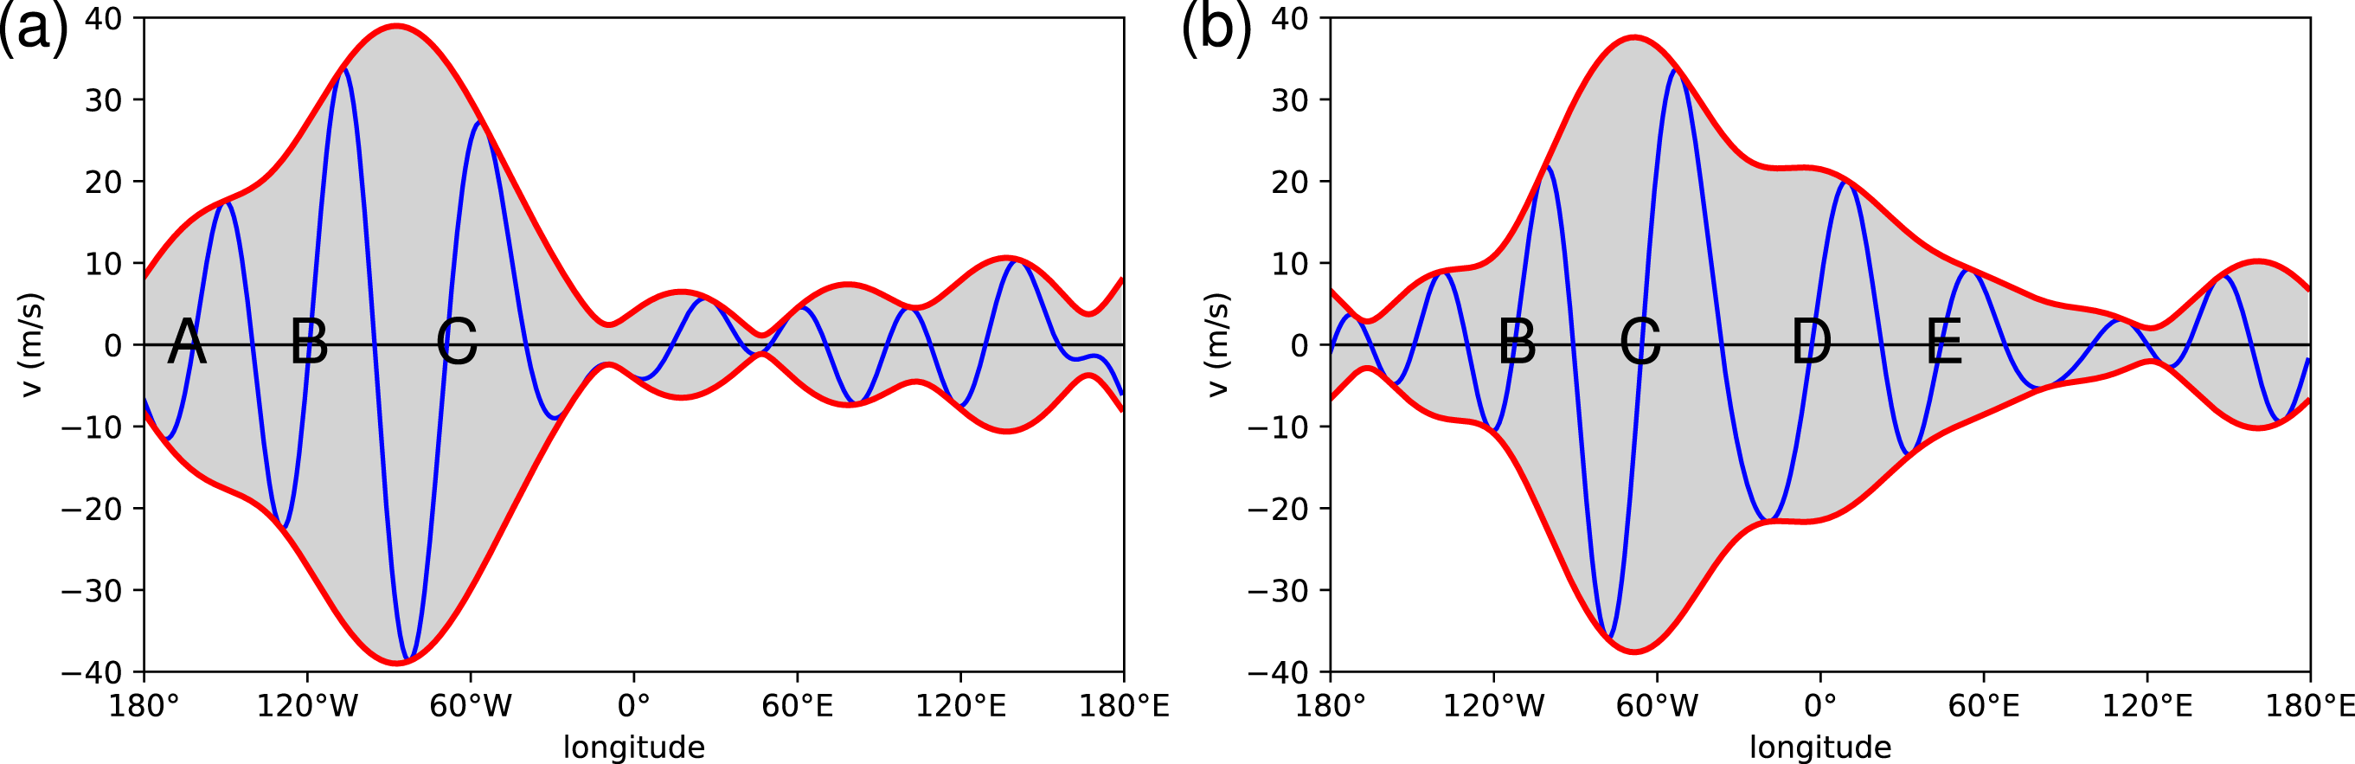
From: Rossby Wave Packets on the Midlatitude Waveguide—A Review
Mon. Wea. Rev.. 2018;146(7):1965-2001. doi:10.1175/MWR-D-16-0483.1
shows v
40-60N
Figure Legend:
Northern Hemisphere RWP at (a) 0000 UTC 7 Aug and (b) 0000 UTC 9 Aug 2002. Both panels show the 300-hPa meridional wind v (blue line, in m s⁻¹) restricted to zonal wavenumbers 4–10 and averaged over 40°–60°N, as well as the corresponding envelope (red lines). The position of individual troughs is diagnosed by the change from negative to positive υ and denoted by capital letters A, B, C,.... The upstream trough A has practically vanished from the RWP during the 48-h time span, while two downstream troughs D and E have been created during that time.
Copyright © 2020 American Meteorological Society

Slide 21
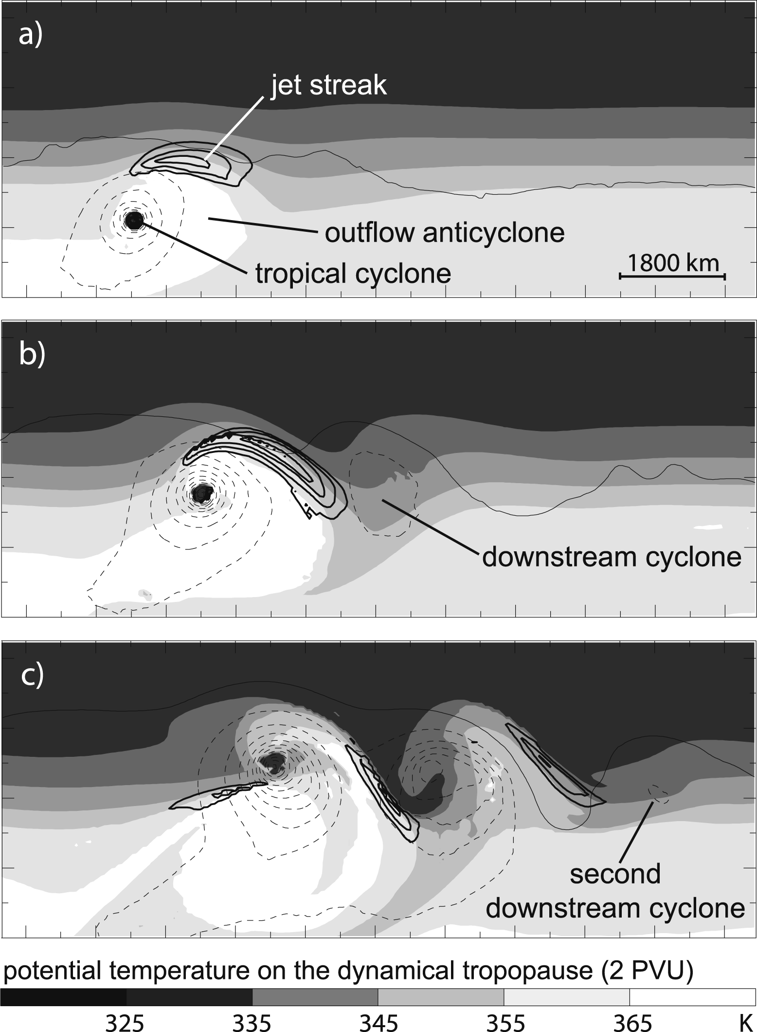
From: Rossby Wave Packets on the Midlatitude Waveguide—A Review
Mon. Wea. Rev.. 2018;146(7):1965-2001.
doi:10.1175/MWR-D-16-0483.1
Figure Legend:
Illustration of the excitation of an RWP by the extratropical transition of a tropical cyclone. (a) 120, (b) 156, and (c) 192 h, respectively, into an idealized numerical experiment with an initially straight jet. The shading denotes potential temperature θ, and the bold solid contours depict wind speed (45 m s⁻¹) on the dynamical tropopause, here defined as the 2-PVU surface. Thin contours show surface pressure, every 5 hPa, dashed for 990 hPa and lower. The horizontal scale is given in (a). [The figure is Figs. 2a–c from Riemer et al. (2008), with modifications.]
Copyright © 2020 American Meteorological Society

Slide 22
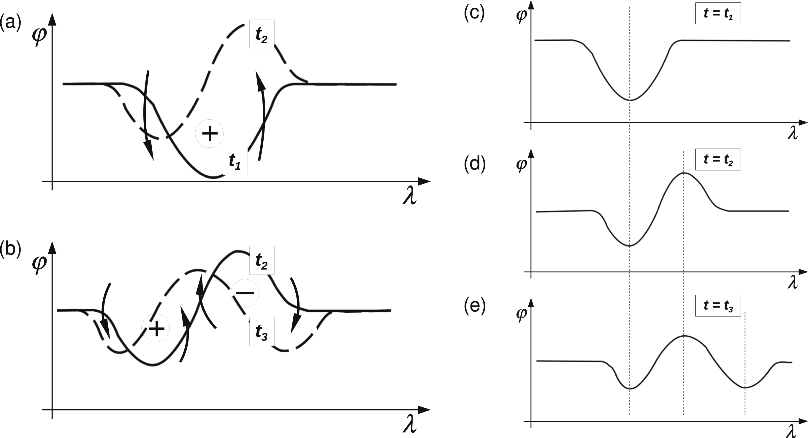
From: Rossby Wave Packets on the Midlatitude Waveguide—A Review
Mon. Wea. Rev.. 2018;146(7):1965-2001. doi:10.1175/MWR-D-16-0483.1
Figure Legend:
Qualitative explanation of barotropic downstream development in the framework of PV thinking. Each panel represents a latitude–longitude map with the lines depicting contours of PV at different times (). The PV gradient of the background atmosphere is northward (i.e., upward in the figure). (left) The circled plus and minus signs represent PV anomalies; the curved arrows represent the wind field associated with these PV anomalies; the solid PV contour depicts an early stage, while the dashed contour represents the situation a short time later (i.e., after the wind had some time to advect the initial contour). (a) The time interval and (b) time interval . (right) The scenario in a frame of reference in which the phase of the troughs and ridges is stationary.
Copyright © 2020 American Meteorological Society

Slide 23
Lab assignment II for the week
Rossby wave group velocity energetics (downstream development):
depends on
ageostrophic wind u_{a}
Waves here strengthen
Waves here weaken
Energy flux

Slide 24
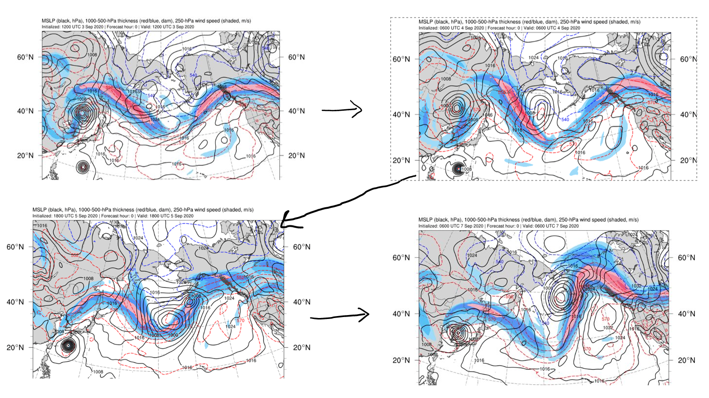
Early Sep 2020: Oregon fires blow up (wind), Colorado snow, etc.

Slide 25
